Slide 1
Proliferation of Weapons of Mass Destruction
M.A.(Security and Defence Laws) and P.G. Diploma (Advanced Maritime Laws)
15 Sep 19
Module III
Maritime Crimes & Proliferation of Weapons of Mass Destruction
Lt Gen A V Subramanian (Retd) AVSM, VSM

Slide 2
Impact of WMD
“Weapons of Mass Destruction (WMD’s)”: Nuclear, chemical and biological weapons distinguished by their lethality and inability to discriminate targets
    E.g. Non combatants likely to be killed
  Usually have to combined with a method of “delivery” –missiles etc.
What is the value of these capabilities?
  Cheaper than conventional armies – ultimate form of asymmetric warfare
  Highly effective form of deterrence
  Can be a significant source of compelence and political leverage
    E.g. North Korea

Slide 3
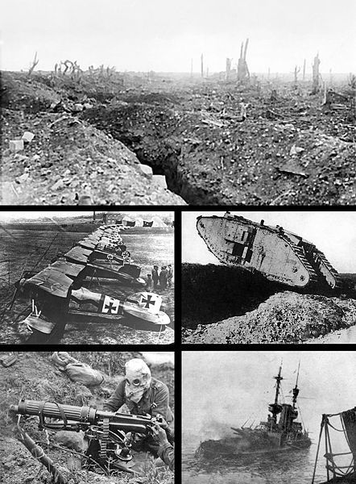
World War I
Notes:
French first used tear gas; Germans mustard gas in Poland.
Widespread in Second Battle of Ypres in 1915
To this day unexploded WWI-era chemical ammunition is still frequently uncovered when the ground is dug in former battle or depot areas and continues to pose a threat to the civilian population in Belgium and France and less commonly in other countries. The French and Belgian governments have had to launch special programs for treating discovered ammunition.
After the war, most of the unused German chemical weapon agents were dropped into the Baltic Sea, a common disposal method among all the participants in several bodies of water. Over time, the salt water causes the shell casings to corrode, and mustard gas occasionally leaks from these containers and washes onto shore as a wax-like solid resembling ambergris. Even in this solidified form, the agent is active enough to cause severe

Slide 4
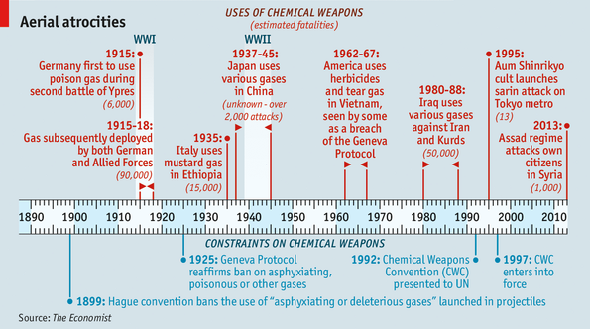
Chemical
Notes:
Poison arrows used by hunter-gatherer societies
Peloponnesian War - Athens vs. Sparta,
5th century BC
-Spartan forces used mixture of wood, pitch, and sulfur
-Athens used hellebore roots to poison the water in an aqueduct leading from the Pleistrus River
Reinaissance
-Leonardo proposed using arsenic & verdigris for ship artillery

Slide 5
Biological
Living organisms
  Anthrax
Cold War focused on retaliation
A Poor Nation’s WMD
Iraq
Nearly impossible to detect
Dual-use technologies

Slide 6
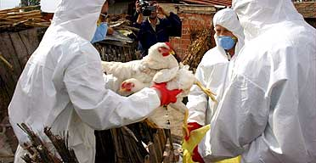
Biological Threat
H5N1/Bird Flu

Slide 7
International Treaties
1899 Hague Conference
  Bans shells filled with asphyxiating gas, despite one vote against by the US
1925 Geneva Protocol
  Bans chemical & biological weapons
  Nothing on production, storage, or transfer
1993 Chemical Weapons Convention
Notes:
Hague Conference
-Bans shells filled w/ asphyxiating gas, despite one vote against by the US
Geneva Protocol
-in the US, the Protocol languished in the Senate until 1975, when it was finally ratified.
-Fascist Italy uses mustard gas during invasion of Ethiopia
-Japan uses poison gas when invading the Chinese, but never against the West
Was not widely used in WWII (mostly Nazi camps)
Chemical Weapons Convention
-Earlier, Reagan & Gorbachev agree to eliminate stockpiles
-182 of 195 states recognized by the UN are party to the treaty. States that signed but didn’t ratify the treaty are: Bahamas, Congo, Dominican Republic, Guinea-Bissau, Israel, and Myanmar
-States that didn’t sign the treaty were: Angola, North Korea, Egypt, Iraq, Lebanon, Somalia, Syria

Slide 8
1993 Chemical Weapons Convention
Bans:
* Developing, producing, acquiring, stockpiling, or retaining chemical weapons.
* Direct or indirect transfer of chemical weapons.
* Chemical weapons use or military preparation for use.
* Assisting, encouraging, or inducing other states to engage in CWC-prohibited activity.
* Riot control agents “as a method of warfare.”
  Didn’t ratify/sign: Bahamas, Congo, Dominican Republic, Guinea-Bissau, Israel, Myanmar, Angola, North Korea, Egypt, Iraq, Lebanon, Somalia, Syria

Slide 9
DARPA : 60th Anniversary Symposium
Combating Emerging Weapons of Mass Destruction and Terror Threats
  Moderator: Dr. Valerie Browning, Director of DARPA Defense Sciences Office (DSO)
  Keynote: Dr. Vincent Tang – DARPA, DSO
  The Honorable Andrew “Andy” Weber – Former Assistant Secretary of Defense for Nuclear, Chemical, and Biological Defense Programs
  Dr. Siegfried Hecker – Center for International Security and Cooperation, Stanford University
  Mr. Peter Bergen – Journalist

Slide 10
Questions?

